Slide 1
ME 165
Basic Mechanical Engineering
Lecture 8
Kinematics of Particles
Sadia Tasnim
Lecturer
Department of Mechanical Engineering, BUET

Slide 2
Introduction of Dynamics
Engineering Mechanics
Statics: Study of bodies in equilibrium
Dynamics: Study of motion
1. Kinematics: concerned with geometric aspects of motion, e.g. s, v, a and t
Newton’s 1st Law:
𝑭_{𝑅} = 0
2. Kinetics: concerned with
how forces causing the motion
Newton’s 2nd Law: 𝑭_{𝑅} = 𝑚𝒂

Slide 3

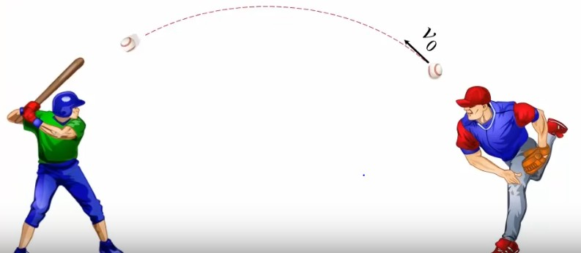
Introduction of Dynamics
Kinematics: concerned with geometric aspects of motion, e.g. s, v, a and t
shown as scalars for a simpler demonstration
𝑡 = 0
𝑡
𝑡 + 𝑑𝑡
𝒅𝒔
𝑠
𝒗 =
𝒅𝒕
𝑠 + 𝑑𝑠
𝒅𝒗 𝒅^{𝟐}𝒔
𝒂 = =
𝒅𝒕 𝒅𝒕^{𝟐}

Slide 4

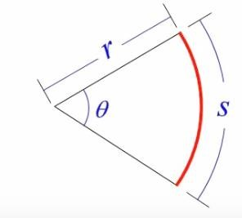
Introduction of Dynamics
𝒅𝒔
𝟏. 𝒗 =
𝒅𝒕
𝑡 = 0
𝑡
𝑡 + 𝑑𝑡
𝒅𝒗
𝟐. 𝒂 =
𝒅𝒕
𝑠
𝑠 + 𝑑𝑠
𝟑. 𝑭 = 𝒎𝒂
𝟒. 𝒔 = 𝒓𝜽
Note: only scalar equations are shown from here on for simplification purpose

Slide 5
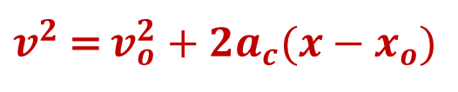
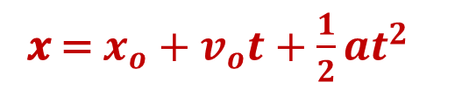

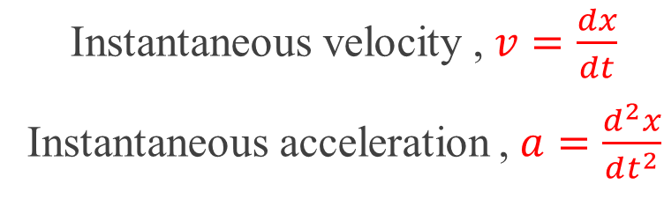
Rectilinear Motion
O
𝑣₁
𝑣₂
−𝑥₁
𝑥₁
𝑡₁
𝑥₂
𝑡₂
𝒙(𝒕): function of time
Instantaneous velocity , $v=\frac{dx}{dt}$
Instantaneous acceleration ,$a=\frac{d^{2}x}{dt^{2}}$
𝒗 =$v_{o}+a_{c}t$
Uniformly Accelerated Rectilinear Motion
Uniform Rectilinear Motion
𝒙 = $x_{o}+v_{o}t+\frac{1}{2}at^{2}$
𝒙 = 𝒙_{𝟎} + 𝒗_{𝒄}𝒕
$v^{2}$ = $v_{o}^{2}+{2a}_{c}(x−x_{o})$

Slide 6
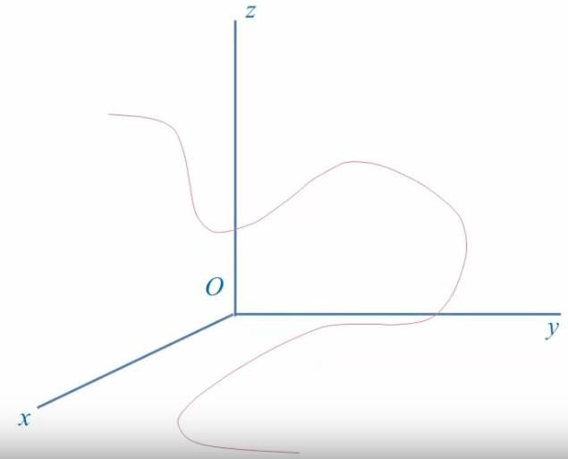



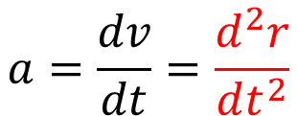
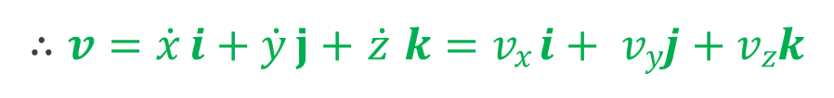

Curvilinear Motion
The motion of a particle follows a curved path.
𝒓 = 𝑥𝒊 + 𝑦𝒋 + 𝑧𝒌
𝒓 𝑡 : 𝑓𝑢𝑛𝑐𝑡𝑖𝑜𝑛 𝑜𝑓 𝑡𝑖𝑚𝑒
∆𝒓 = 𝒓′ − 𝒓
tangent to path
𝑧𝒌
𝑃(𝑥, 𝑦, 𝑧)
𝑃′(𝑥′, 𝑦′, 𝑧′)
∆𝒓
𝒓′
𝑦𝒋
𝒓
𝒗 = lim ^{Δ𝒓} = ^{𝑑𝒓}
∆𝑡→0 Δ𝑡
𝑑𝑡
∴ 𝒗 = $\dot{x}$ 𝒊 + $\dot{y}$ 𝐣 + $\dot{z}$ 𝒌 = 𝑣_{𝑥}𝒊 + 𝑣_{𝑦}𝒋 + 𝑣_{𝑧}𝒌
𝑥𝒊
$$a=\frac{dv}{dt}=\frac{d^{2}r}{dt^{2}}$$
∴ 𝒂 = $\ddot{x}$ 𝒊 + $\ddot{y}$ 𝒋 + $\ddot{z}$ 𝒌 = 𝑎_{𝑥}𝒊 + 𝑎_{𝑦}𝒋 + 𝑎_{𝑧}𝒌

Slide 7
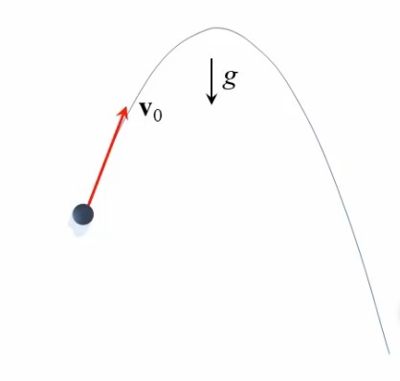


Motion of a Projectile
g
y
(𝒗₀)_{𝑦}
@ 𝑡𝑖𝑚𝑒 𝑡
𝑃(𝑥, 𝑦)
Motion with constant acceleration:
𝒗_{𝑥}
𝒔 = 𝒔_{𝟎} + 𝒗_{𝟎}𝒕 + _{𝟐} 𝒂_{𝒄}𝒕
𝒗 = 𝒗_{𝟎} + 𝒂_{𝒄}𝒕
𝟏
𝟐
(𝒗₀)_{𝑥}
𝑃(𝑥₀, 𝑦₀)
𝒗_{𝑦}
𝒗
𝟐 𝟐
𝒗 = 𝒗 + 𝟐𝒂
𝒔 − 𝒔_{𝟎}
x
𝟎
𝒄
O

Slide 8
Motion of a Projectile
Horizontal motion:
𝑎_{𝑥} = 𝑎_{𝑐} = 0
𝑥 = 𝑥₀ + (𝒗₀)_{𝑥}𝑡
𝒗_{𝑥} = (𝒗₀)_{𝑥}
Note: Horizontal motion and vertical motion take
place during the same time.
y
Vertical motion:
𝑎_{𝑦} = 𝑎_{𝑐} = −𝑔
(𝒗₀)_{𝑦}
@ 𝑡𝑖𝑚𝑒 𝑡
𝑃(𝑥, 𝑦)
𝒗_{𝑥}
1
2
y = 𝑦₀ + (𝒗₀)_{𝑦}𝑡 − ₂ 𝑔𝑡
(𝒗₀)_{𝑥}
𝑃(𝑥₀, 𝑦₀)
𝒗_{𝑦}
𝒗
𝒗_{𝑦} = (𝒗₀)_{𝑦}−𝑔𝑡
𝒗_{𝑦}^{𝟐} = (𝒗 )^{𝟐}−2𝑔 𝒚 − 𝒚
0 𝒚
𝟎
O
x

Slide 9
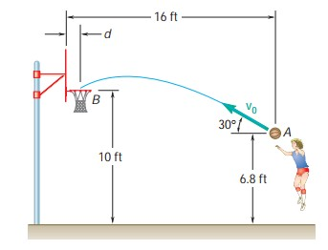
Motion of a Projectile
Problem:
A basketball player shoots when she is 16 ft from the backboard. Knowing that the ball has an initial velocity 𝒗₀ at an angle of 30° with the horizontal, determine the value of 𝒗₀ when d =9 in.

Slide 10
Motion of a Projectile
16
Solution:
Horizontal motion: 𝒙 = 𝒙_{𝟎} + (𝒗_{𝟎})_{𝒙}𝒕
7 ft
At B, 16 − 𝑑 = 0 + (𝒗_{𝟎} cos 30° × 𝑡_{𝐵})
3.2 ft
⇒ 𝑡 =
16−𝑑
𝐵
𝒗_{𝟎} cos 30°
𝟏
𝟐
Vertical motion: 𝒚 = 𝒚_{𝟎} + (𝒗_{𝟎})_{𝒚}𝒕 − _{𝟐} 𝒈𝒕
1
At B, 3.2 = 0 + 𝒗_{𝟎} sin 30° × 𝑡_{𝐵} − × 32 × 𝑡²
2
16−𝑑
𝐵
⇒ 3.2 = 0 + 𝒗 sin 30° ×
− ¹ × 32 × (
16−𝑑
₎2
𝟎
𝒗_{𝟎} cos 30°
2
𝒗_{𝟎} cos 30°
⇒ 𝑣² =
2𝑔(16−𝑑)²
0
3[ ¹ 16−𝑑 −3.2]
3
∴ 𝒗_{𝟎} = 𝟐𝟗. 𝟖 𝒇𝒕/𝒔

Slide 11
Relative Motion
O
A
B
𝑥_{𝐴}
^{𝑥}𝐵/𝐴
𝑥_{𝐵}
Relative Position:
𝒙_{𝐵/𝐴} = 𝒙_{𝐵} − 𝒙_{𝐴}
⇒ 𝒙_{𝐵} = 𝒙_{𝐴} + 𝒙_{𝐵/𝐴}
⇒ 𝒗_{𝐵} = 𝒗_{𝐴} + 𝒗_{𝐵/𝐴}
⇒ 𝒂_{𝐵} = 𝒂_{𝐴} + 𝒂_{𝐵/𝐴}
Relative Velocity:
𝒗_{𝐵/𝐴} = 𝒗_{𝐵} − 𝒗_{𝐴}
Relative Acceleration:
𝒂_{𝐵/𝐴} = 𝒂_{𝐵} − 𝒂_{𝐴}

Slide 12

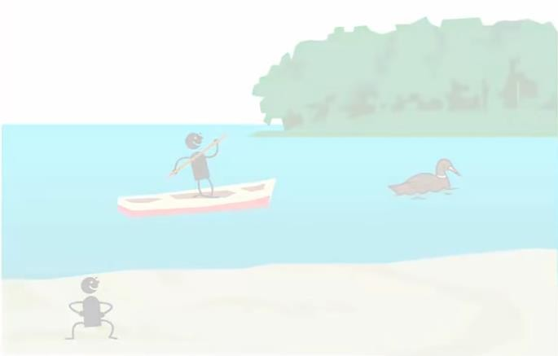


Motion Relative to Frame in Translation
z'
Relative Position:
𝒓_{𝐵/𝐴} = 𝒓_{𝐵} − 𝒓_{𝐴}
⇒ 𝒓_{𝐵} = 𝒓_{𝐴} + 𝒓_{𝐵/𝐴}
Translating Frame
z
A
O
y'
Relative Velocity:
^{𝒓}𝐵/𝐴
B
𝒗 = 𝒗 − 𝒗
x'
𝒓_{𝐴}
𝐵/𝐴 𝐵 𝐴
𝒓
⇒ 𝒗_{𝐵} = 𝒗_{𝐴} + 𝒗_{𝐵/𝐴}
𝐵
𝒓_{𝐴} and 𝒓_{𝐵} are absolute positions
𝒓_{𝐵/𝐴} is relative position of B relative to A.
Relative Acceleration:
𝒂_{𝐵/𝐴} = 𝒂_{𝐵} − 𝒂_{𝐴}
⇒ 𝒂_{𝐵} = 𝒂_{𝐴} + 𝒂_{𝐵/𝐴}
O
y
x
Fixed Reference Frame
𝒓_{𝐵/𝐴} = 𝒓_{𝐵} − 𝒓_{𝐴}

Slide 13
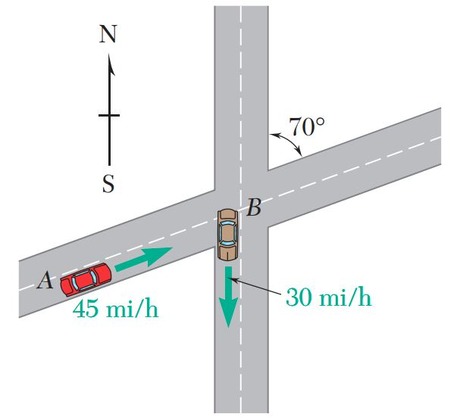
Relative Motion
Problem:
Three seconds after automobile B passes through the intersection shown, automobile A passes through the same intersection. Knowing that the speed of each automobile is constant, determine (a) the relative velocity of B with respect to A, (b) the change in position of B with respect to A during a 4-s interval, (c) the distance between the two automobiles 2 s after A has passed through the intersection.

Slide 14
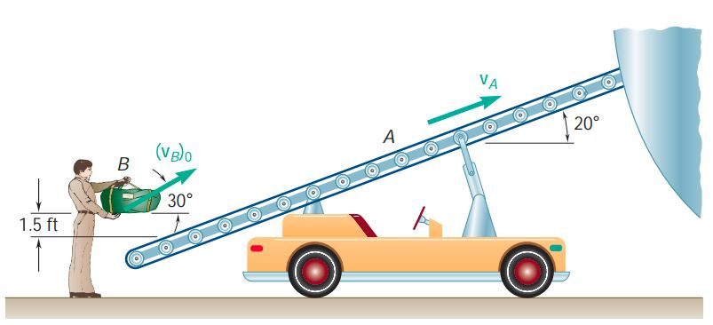
Relative Motion
Problem:
Conveyor belt A, which forms a 20° angle with the horizontal, moves at a constant speed of 4 ft/s and is used to load an airplane. Knowing that a worker tosses duffel bag B with an initial velocity of 2.5 ft/s at an angle of 30° with the horizontal, determine the velocity of the bag relative to the belt as it lands on the belt.

Slide 15
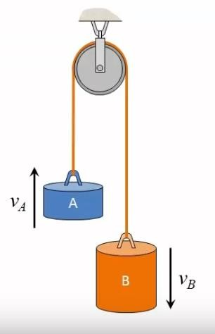
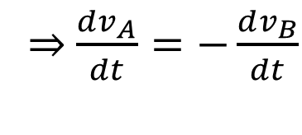
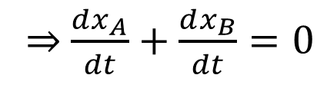
Dependent Motion
𝑥_{𝐴} + 𝑙_{𝑠𝑒𝑚𝑖} + 𝑥_{𝐵} = 𝑙_{𝑇}
^{𝑙}𝑠𝑒𝑚𝑖
Datum
⇒ 𝑥_{𝐴} + 𝑥_{𝐵} = C
O
𝑑(𝑥_{𝐴} + 𝑥_{𝐵}) 𝑑
⇒
= (𝐶)
𝑥_{𝐴}
𝑑𝑡 𝑑𝑡
𝑥_{𝐵}
⇒ $\frac{dx_{A}}{dt}+\frac{dx_{B}}{dt}=0$
⇒ 𝑣_{𝐴} = −𝑣_{𝐵}
⇒ $\frac{dv_{A}}{dt}=−\frac{dv_{B}}{dt}$
⇒ 𝑎_{𝐴} = −𝑎_{𝐵}

Slide 16
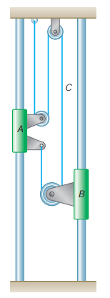
Dependent Motion
9
Problem:
Collar A starts from rest and moves upward with a constant acceleration. Knowing that after 8 s the relative velocity of collar B with respect to collar A is 24 in./s. Determine-
the accelerations of A and B,
the velocity and the change in position of B after 6 s.

Slide 17
Dependent Motion
10
Solution:
𝟐𝒚_{𝑨} + 𝒚_{𝑩} + 𝒚_{𝑩} − 𝒚_{𝑨}
= 𝒄𝒐𝒏𝒔𝒕𝒂𝒏𝒕
+
⇒ 𝒚 + 𝟐𝒚
= 𝒄𝒐𝒏𝒔𝒕𝒂𝒏𝒕
𝑦_{𝐴}
𝑨 𝑩
𝑦_{𝐵}
So, 𝒗 + 𝟐𝒗 = 𝟎 and (a)
𝟏
𝒂_{𝑨} + 𝟐𝒂_{𝑩} = 𝟎 ⇒ 𝒂_{𝑩} = − _{𝟐} 𝒂_{𝑨}
0
𝑨 𝑩
0
Now, 𝒗_{𝐴} = (𝒗₀)_{𝐴}+𝒂_{𝑨}𝑡 = 𝒂_{𝑨}𝒕
and 𝒗_{𝐵} = (𝒗₀)_{𝐵}+𝒂_{𝑩}𝑡 = 𝒂_{𝑩}𝒕
Here, 𝒗_{𝐵/𝐴} = 𝒗_{𝐵} − 𝒗_{𝐴} =
𝟑
𝒂_{𝑩} − 𝒂_{𝑨} 𝒕 = − _{𝟐} 𝒂_{𝑨}𝒕
𝟑
𝒊𝒏 𝒊𝒏
⇒ 𝟐𝟒 = − 𝒂_{𝑨} × 𝟖
𝟐
⇒ 𝒂_{𝑨} = −𝟐 _{𝒔𝟐} = 𝟐 _{𝒔𝟐}
_{= 𝟏} 𝒊𝒏
∴ 𝒂
𝑩
_{𝒔}𝟐
(b) 𝒗_{𝐵} = 𝒂_{𝑩}𝒕 = 𝟏 × 𝟔 = 𝟔 𝒊𝒏/𝒔
𝟏
𝟐
𝒚_{𝑩} = (𝒚₀)_{𝐵}+(𝒗₀)_{𝐵}𝒕 + _{𝟐} 𝒂_{𝑩}𝒕
∴ 𝒚_{𝑩} −
𝒚_{𝟎 𝑩} = 𝟏𝟖 𝒊𝒏

Slide 18
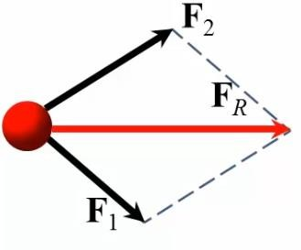

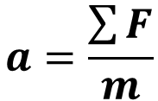
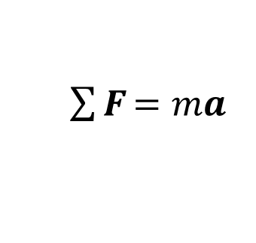
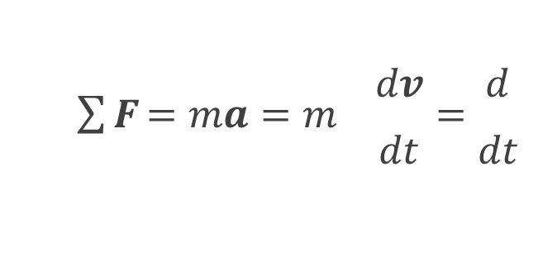
Newton’s 2nd Law of Motion
inertia force
$\sum{\text{F}}$ = 𝑚𝒂
Equation of motion
Kinetic diagram
$$a=\frac{\sum{F}}{m}$$
Accelerated motion
The acceleration of the movement of an object is proportional to the resultant force and is also in the same direction of the resultant force.
𝑑𝒗 𝑑
$\sum{\text{F}}$ = 𝑚𝒂 = 𝑚 =
𝑑𝑡 𝑑𝑡
𝑑𝑳
𝑚𝒗 = = 𝑳
𝑑𝑡
Here, 𝑳 = 𝑚𝒗 is the linear momentum of particle

Slide 19
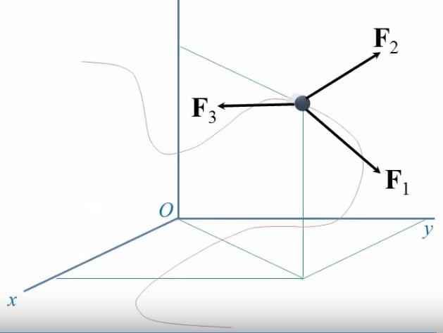
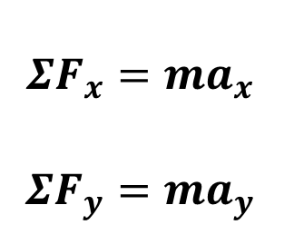
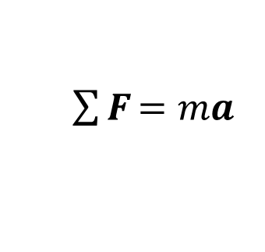
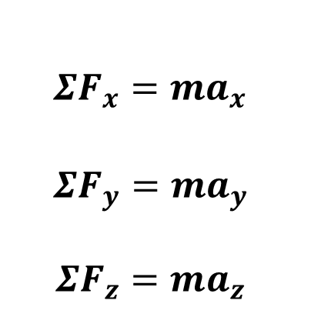
Equation of Motion: Rectangular Co-ordinates
$\sum{\text{F}}$ = 𝑚𝒂
$$ΣF_{x}=ma_{x}$$
$$ΣF_{y}=ma_{y}$$
$$ΣF_{z}=ma_{z}$$
3D
$$ΣF_{x}=ma_{x}$$
$$ΣF_{y}=ma_{y}$$
2D

Slide 20
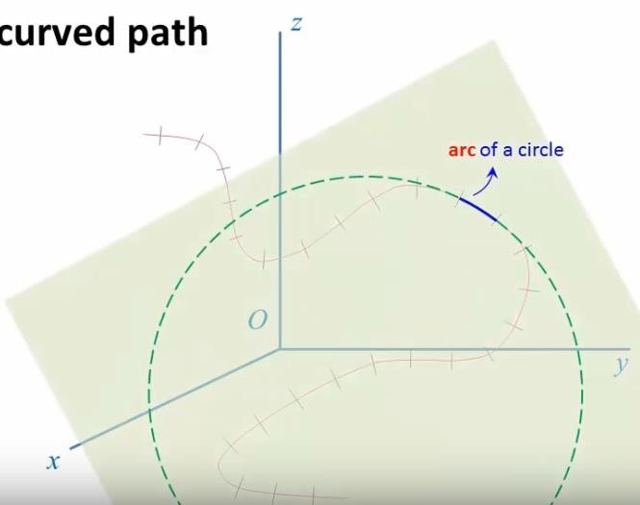
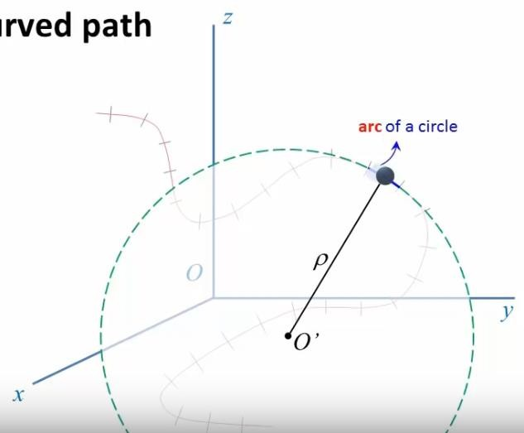
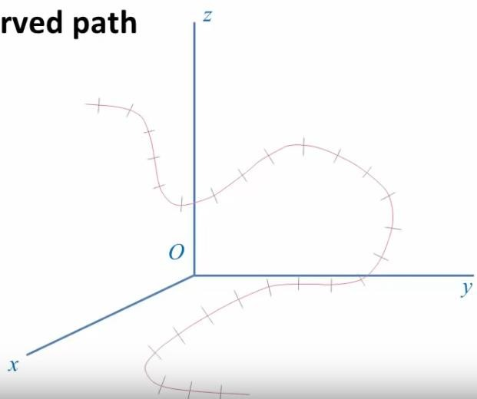
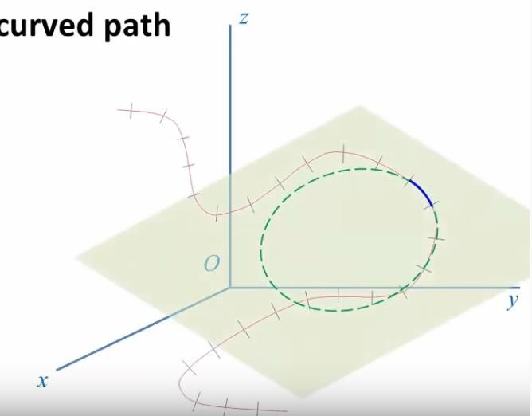
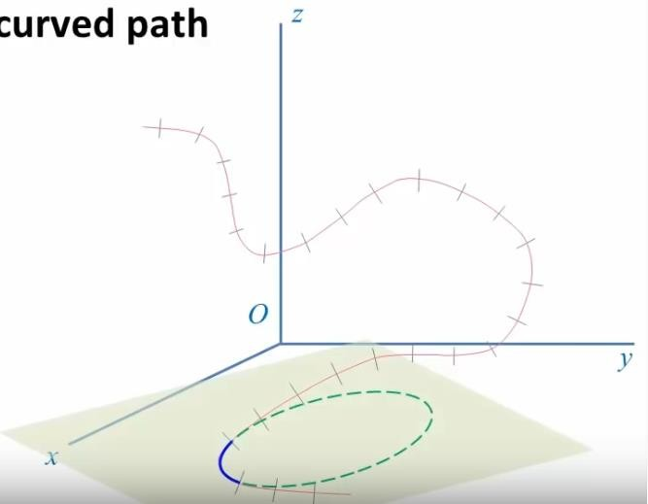
Curvilinear Motion: Tangential & Normal Components
2D Plane
t
Osculating plane
n

Slide 21
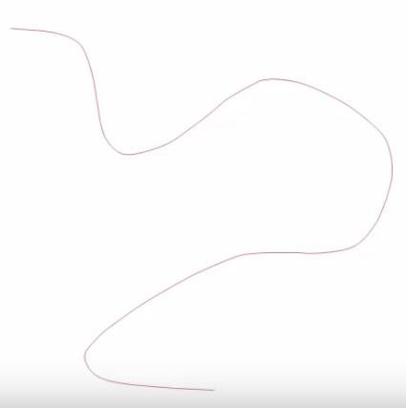
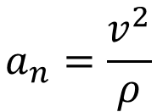
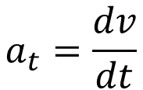
Curvilinear Motion: Tangential & Normal Components
𝒗 = 𝑣𝒖_{𝑡}
𝒂 = 𝑎_{𝑡}𝒖_{𝑡} + 𝑎_{𝑛}𝒖_{𝑛}
Here,
$$a_{t}=\frac{dv}{dt}$$
$$a_{n}=\frac{v^{2}}{ρ}$$
𝑎 = 𝑎² + 𝑎²
𝑡 𝑛

Slide 22
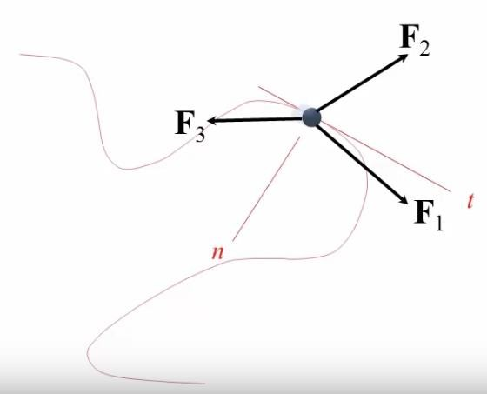
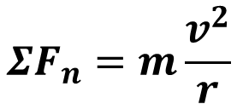
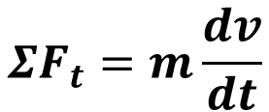
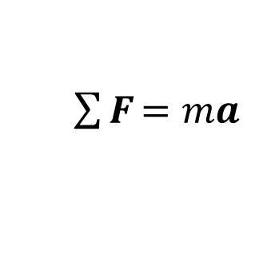
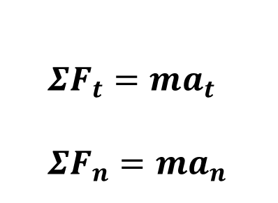
𝑬𝒒^{𝒏} of Motion: Tangential & Normal Components
$\sum{\text{F}}$ = 𝑚𝒂
$$ΣF_{t}=ma_{t}$$
$$ΣF_{n}=ma_{n}$$
𝒂_{𝑡}
𝒂_{𝑛}
$$ΣF_{t}=m\frac{dv}{dt}$$
$$ΣF_{n}=m\frac{v^{2}}{r}$$

Slide 23
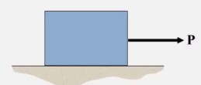
Laws of Dry Friction
Impending motion
F
Always tangent to contact surface and opposite to impending motion
Limiting static frictional force
F
Motionless
(static)
Motion (kinetic)
𝑭_{𝒎} = µ_{𝒔}𝑵
𝑭_{𝒌} = µ_{𝒌}𝑵
Kinetic frictional
force
P

Slide 24
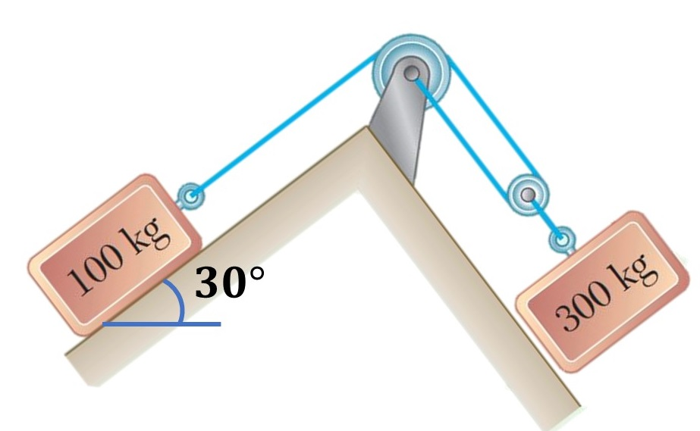
Equation of Motion
Problem:
The two blocks shown starts to move from the rest. The coefficients of friction between blocks and the inclines are 𝜇_{𝑠} = 0.25 and 𝜇_{𝑘} = 0.20. Neglecting the masses of the pulleys, determine-
(a) the acceleration of each block and (b) the tension in the cable.

Slide 25
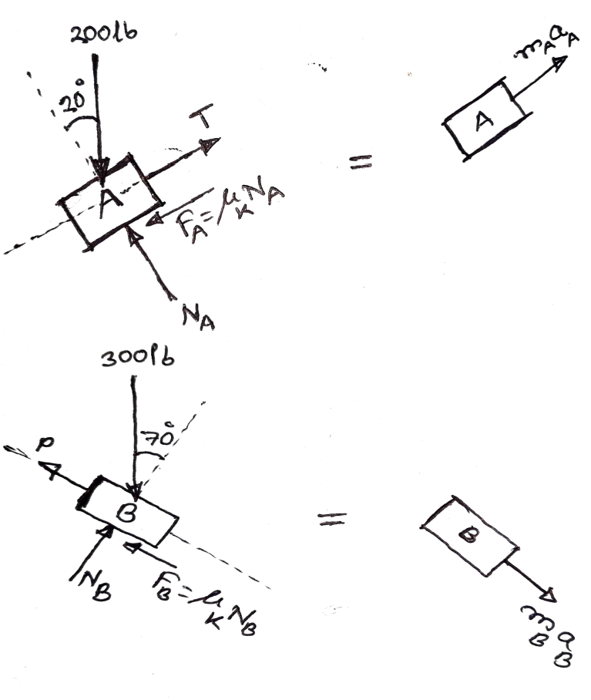
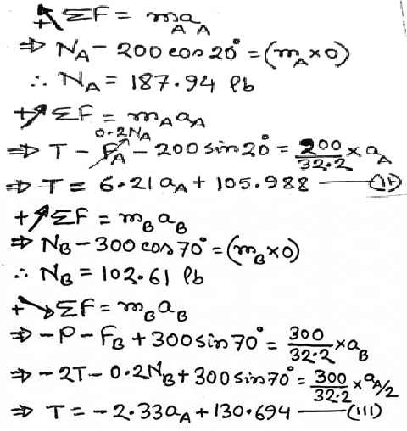
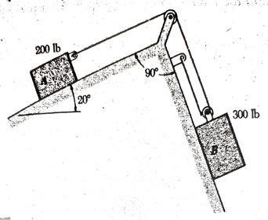
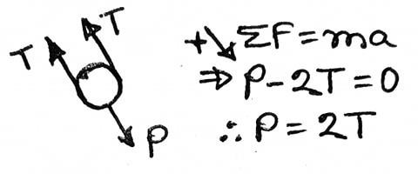
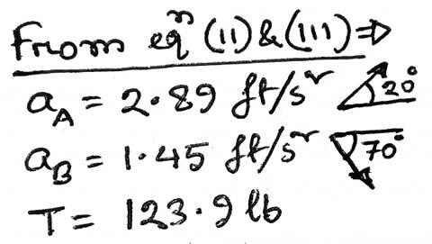
Equation of Motion
9
Solution:
𝑥_{𝐴}
𝑥_{𝐵}
Kinematics: 𝑥_{𝐴} + 2𝑥_{𝐵} = 𝐶
Change in position:
∆𝑥_{𝐴} + 2∆𝑥_{𝐵}= 0
⇒ ∆𝑥_{𝐵}= − ₂ ∆𝑥_{𝐴} = ₂ ∆𝑥_{𝐴} (𝑚𝑎𝑔𝑛𝑖𝑡𝑢𝑑𝑒)
1
⇒ 𝑥_{𝐵} = ₂ 𝑥_{𝐴}
∴ 𝑎_{𝐵} = ₂ 𝑎_{𝐴}------ (1)
1 1
1

